Slide 1
Linux Administration
Secure Shell (SSH)

Slide 2
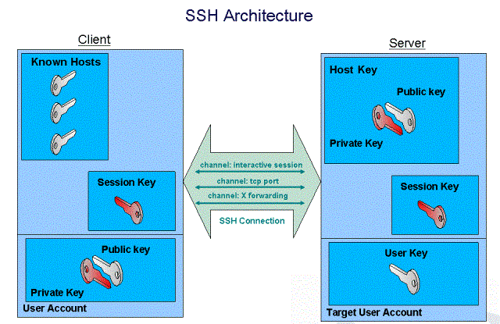

Slide 3
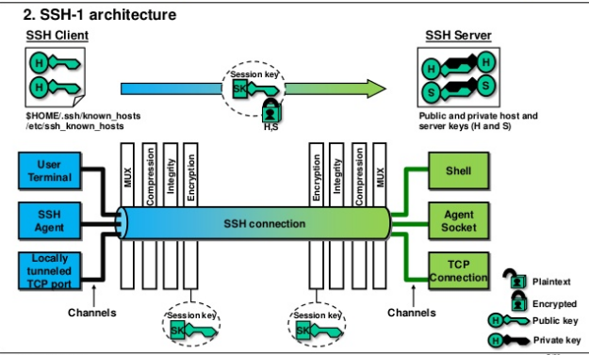

Slide 4
Types of Encryption →
1) Symmetric →
Only one key is used for both encryption & decryption.
It is faster than asymmetric encryption.
2) Asymmetric →
It consist of two keys “Private key” & “Public Key”.
It is faster than symmetric encryption.

Slide 5
Secure Shell (SSH)
SSH is used for login to shell of a remote system.
It uses port no. 22
For using SSH you require to know following information of Remote machine;
IP
Username
Password
ssh <username>@<IP of Destination system>

Slide 6
Difference between Telnet & SSH
Sr. No. | SSH | Telnet
1 | Port no. is 22 | Port no. is 23
2 | Root & any user can login | Only normal user can login
3 | Secure | Non Secure
4 | Data transfer in encrypted form | Transfer in clear text format

Slide 7
SSH-Keygen →
It is used to remotely login with SSH without always assigning password.
ssh-keygen
Press Enter
Enter Passphrase
Renter Passphrase
Now both Public & Private keys are generated.Files are present in “/root/.ssh/”
id_rsa (Private key)
id_rsa.pub (Public Key)

Slide 8
5) ls –la /root/.ssh/
6) ssh-copy-id –i /root/.ssh/id_rsa.pub root@<Destination PC IP>
This command will send this Public key generated to the destination PC to access in “/root/.ssh/” named “authorized_keys”. It consist of Public Key.
Now try to login by ssh, press “yes” ,then entry gets added in “known_host” file.

